Slide 1
Mindset Change & Change Management
Staff Training at Kakumiro District
By Mwebembezi Johnie Kishate
Education Transformation initiatives Uganda

Slide 2
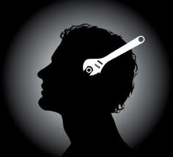

Mind set
A set of beliefs that shape how you make sense of the world and yourself.
It influences how you think, feel and behave in any given situation.
A belief, usually based on past experience that has the potential to prevent one from achieving positive change.

Slide 3
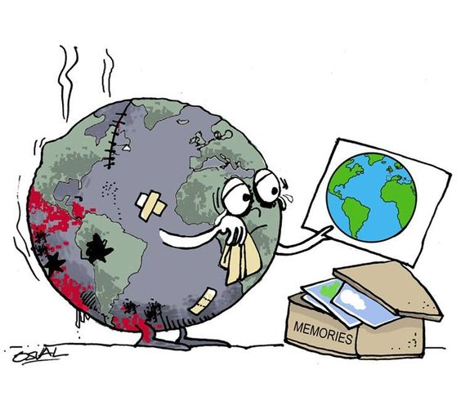
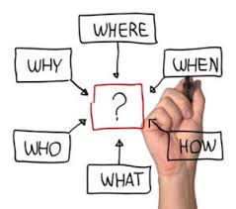
Time & Change !
3 Ps- ( Purpose, Potential & Principle)

Slide 4
Mindset indicators:
Your expectations are stressing you out
you see nothing but negatives
.
You are passionately worried about everything
You are relentlessly resisting the truth
You have a tendency to blame others
You catch yourself living in the past
It has been a while since you learned something new
You secretly want a pain free life
You are never satisfied with what you have

Slide 5
Examples of Mindsets
  Us and Them
  This place will NEVER change
  This place cannot change while so-and-so is still alive.
  This organization has its owners.
  I know it is wrong! Everyone does it so I might as well do it.
  People don’t like me.
  This is not my personal property-I don’t have to look after it.
  I’m always being shouted at. I’m not good enough.
  For this organization to be better our managers must change.
  I don’t know what I can do to change these people

Slide 6
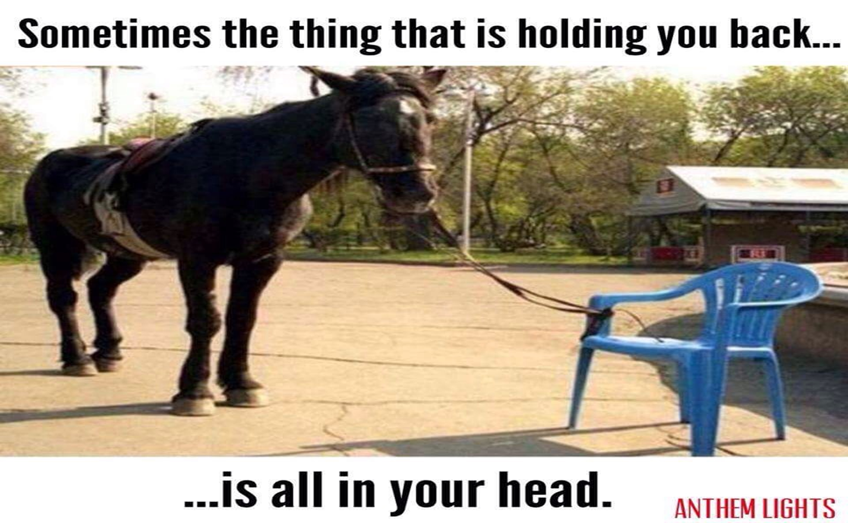
The Mind set Trap … !

Slide 7
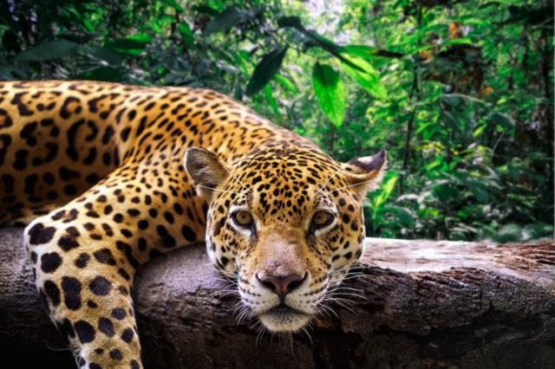
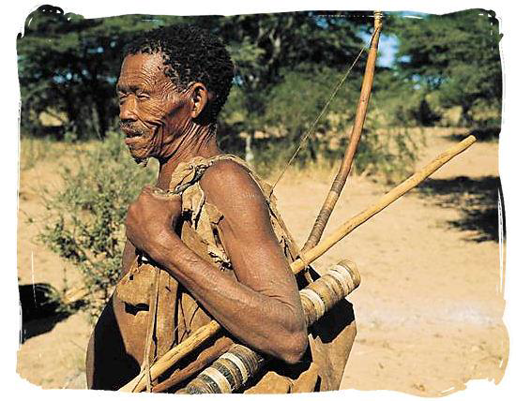
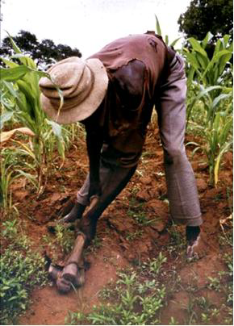
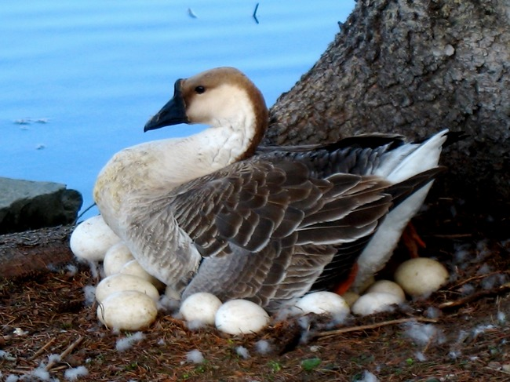
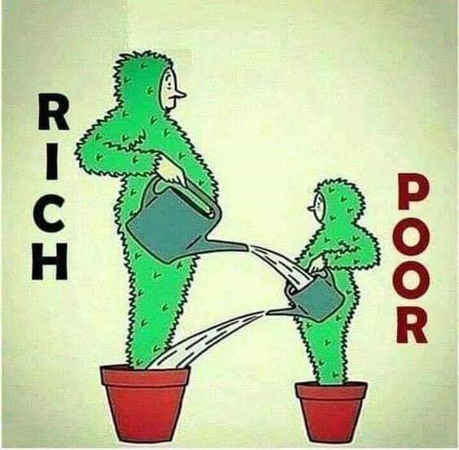
“The status Quo Mentality”.
“What you sow is what you reap”

Slide 8
Mindset Cycles.
Higher Achievement
Increase Effort & Strategies
Growth Mindset
Types of Mindsets
Fixed
Mindset
Reduce Effort & Withdraw
Lower Achievement

Slide 9
Mindset Change:
Fixed | Growth
I will sick to what I know. Either, I am good at it or not | DESIRES. | I want to learn new things. I am Eager to take risks
It is fine the way it is, nothing to change. | SKILLS. | Is this really my best work ? What else can I improve ?
This is a waste of time, there is a lot to figure out. | EFFORT. | I know this will help me, even though it is difficult.
It is easier to give up. I am really not smart | SETBACK | I will use another strategy. My mistakes help me learn
This work is boring. No one likes to do it. | FEEDBACKS | I recognize my weaknesses and I know what to fix
It is easy for him or her. They were born smart. | TALENTED PEERS | I wonder how they did it. Let me try to figure it out.

Slide 10
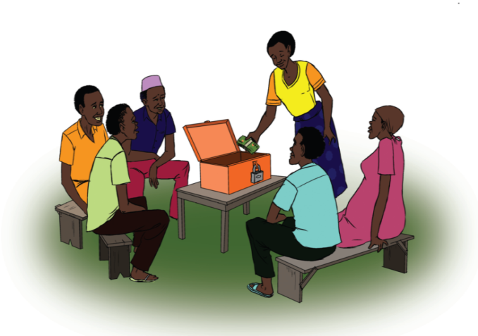
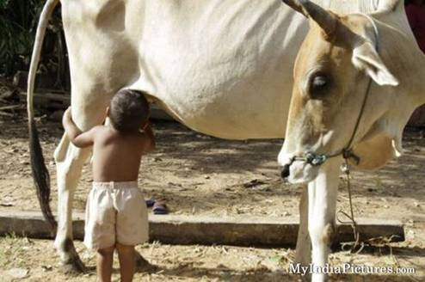

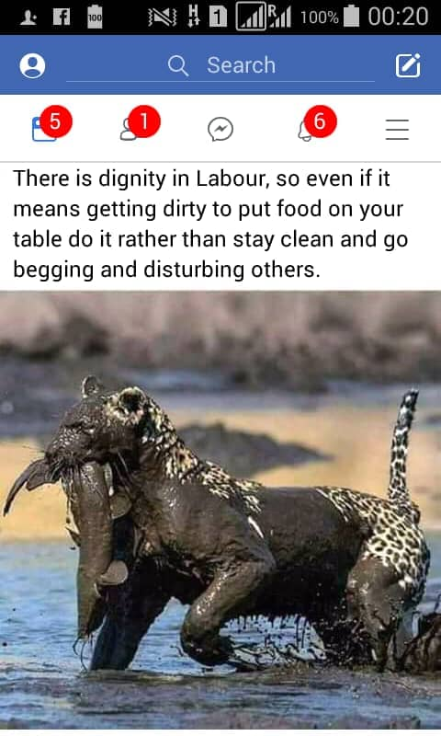
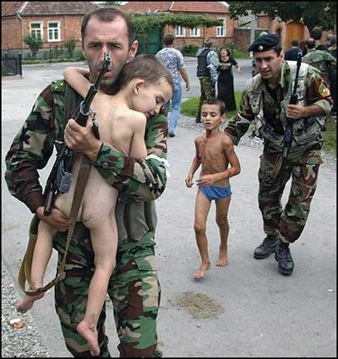

The Growth Mind set situation!
Do not wait for the opportunity, create it !

Slide 11
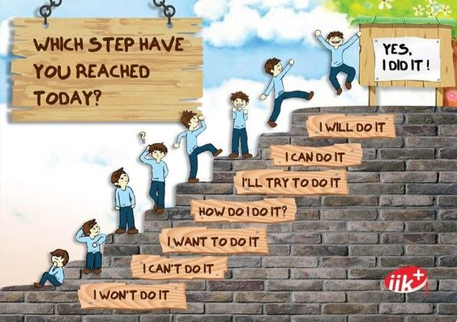

Different stages

Slide 12
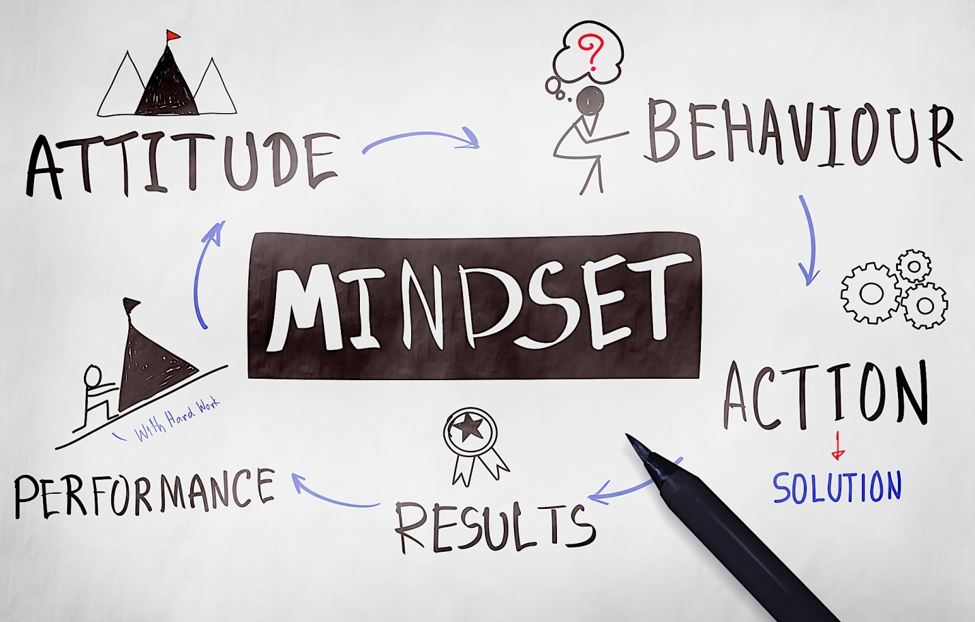
Why Mindset?

Slide 13


Slide 14
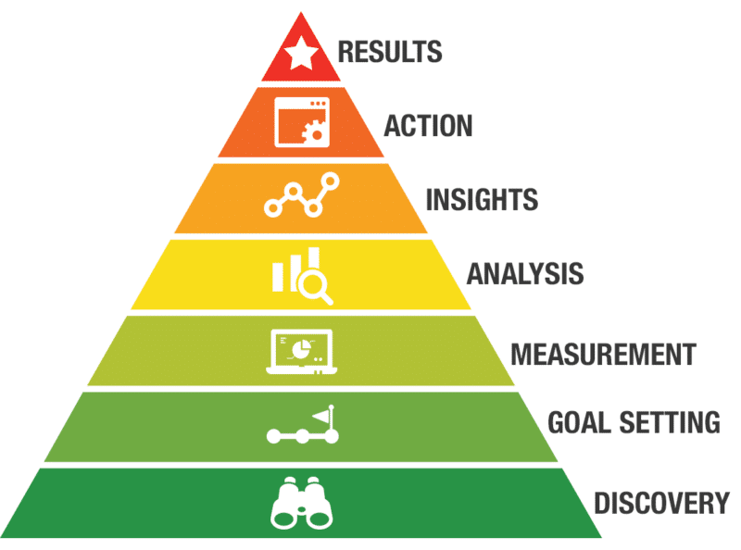

Mindset Ladder

Slide 15



Gender & Teamwork!

Slide 16
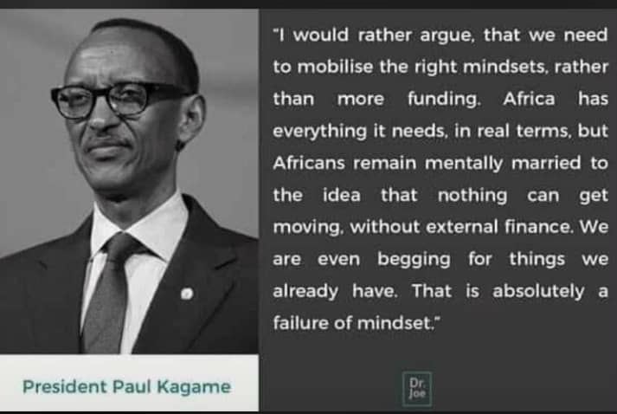

Slide 17
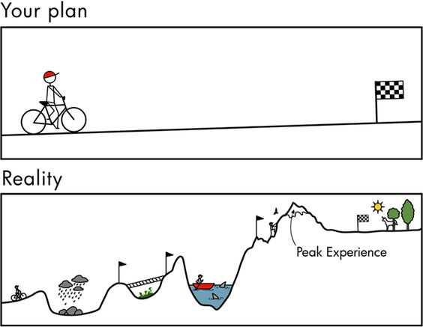
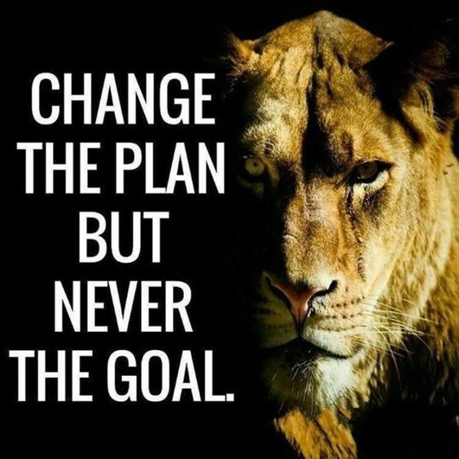
Never Give Up:!

Slide 18


Slide 19



